Slide 1
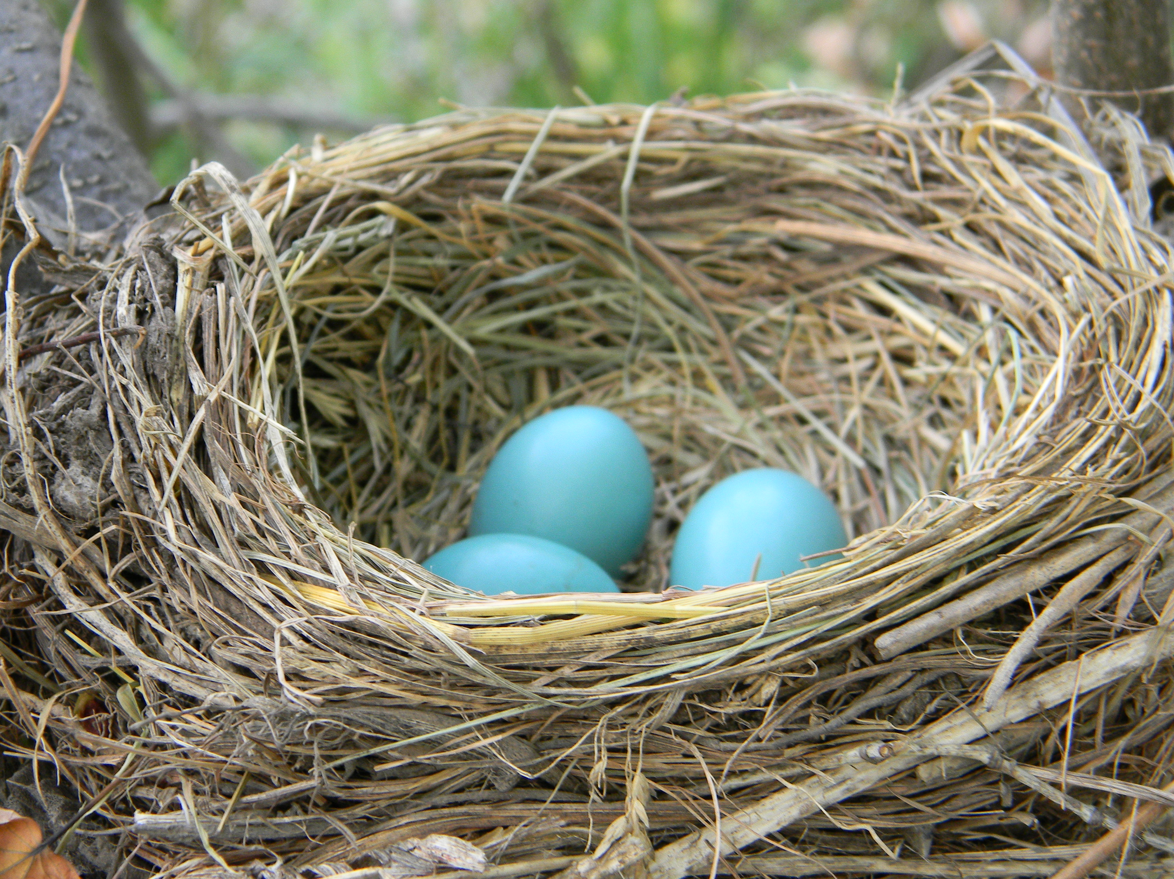
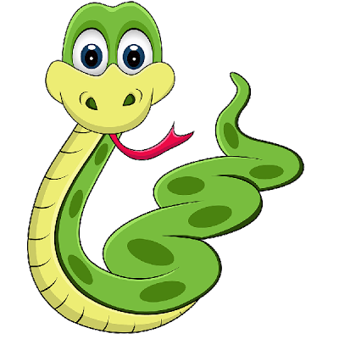
Python Nesting

Slide 2
Objectives
GitHub
Break up a dictionary
Looping through the dictionary
Nest a list in a dictionary

Slide 3
Do you even Git?
Remember to sign up for GitHub or make sure you can retrieve your GitHub username/password from last year.
The Unbuntu OS we are using on the chromebooks are great; however, we have several classes using them besides us and it is unsettling easy for the OS to get wiped (i.e. all your work can be lost!!!)
We can overcome this by committing our file changes to the repository on GitHub. When we do this, we will never lose our work and we can get to it from outside of class!

Slide 4
A Dictionary of Similar Objects
Make a new Python file in your directory called: favorite_languages.py

Slide 5
Dictionary of Similar Objects
You can store different kinds of information about one object in a dictionary
You can also use a dictionary to store one kind of information about many objects
Have you heard of a poll?

Slide 6
favorite_languages.py
Let’s say we wanted to poll a number of people to ask them what their favorite language is.
A dictionary is useful for storing the results of a simple poll

Slide 7
favorite_languages.py
1 favorite_languages = {
2 ‘jen’: ‘python’,
3 ‘sarah’: ‘c’,
4 ‘edward’: ‘ruby’,
5 ‘phil’: ‘python’,
6 }

Slide 8
favorite_languages.py
1 favorite_languages = {
2 ‘jen’: ‘python’,
3 ‘sarah’: ‘c’,
4 ‘edward’: ‘ruby’,
5 ‘phil’: ‘python’,
6 }
We’ve broken up a larger dictionary into several lines.
What is the Key?
What is the Value?
Name of the person who responded to the poll
Their favorite language choice

Slide 9
How to use the dictionary
Given the name of the person who took the poll, you can easily look up their favorite language:
7 print(“Sarah’s favorite language is “ +
8 favorite_languages[‘sarah’].title() +
9 “.”)

Slide 10
Looping Through the Values
A single Python dictionary can contain just a few key-value pairs, or
It can contain MILLIONS of pairs!!!
Since a dictionary can have large amounts of data,
Python lets you loop through a dictionary

Slide 11
Looping through all KEY-VALUE pairs
What if you wanted to see everything stored in your poll’s dictionary?
We could use a for loop:
10 for name, language in favorite_languages.title():
11 print(name.title() + “ ‘s favorite language is “ +
12 language.title() + “.”)
Once you’ve finished your loop, run the code
Pay attention to the spacing: this won’t produce an error, but it’ll display the output clearly

Slide 12
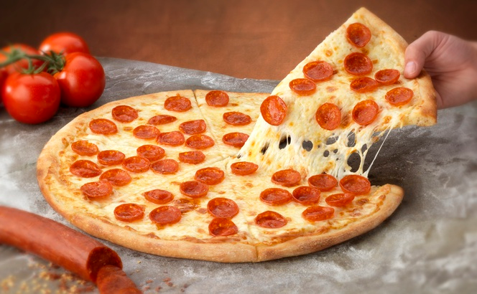
Pizza.py

Slide 13
Nest a list inside of a dictionary
Sometimes it’s useful to put a list inside a dictionary
For example, think about how you might describe a pizza someone is ordering.

Slide 14
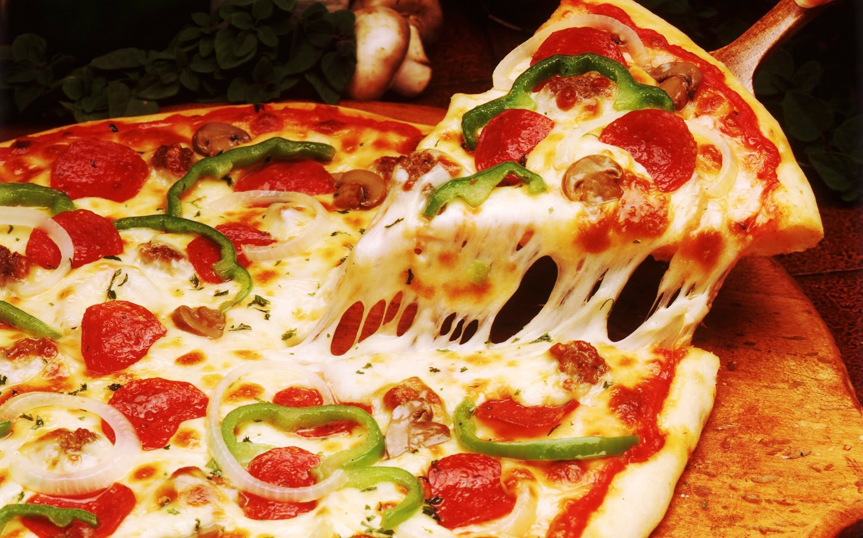
Nest a list inside of a dictionary
Sure if you used a list, all you could store is a list of the pizza toppings
However, you can use a dictionary to effectively describe everything on the
Pizza. Think about it:

Slide 15
pizza.py
Here’s our nested list!
Two kinds of information are being stored for each pizza:
Type of crust & a list of toppings...
1 pizza = {
2 ‘crust’: ‘thick’,
3 ‘toppings’: [‘mushrooms’, ‘pepperoni’, ‘extra cheese’],
4 }

Slide 16
Summarize the order
Let’s summarize our order before building the pizza
5 print(“You ordered a “ + pizza[‘crust’] + “-crust pizza “ +
6 “with the following toppings: ”)
7 for topping in pizza[‘toppings’]:
8 print(“\t” + topping)

Slide 17
Main Idea
Any time you want more than value to be associated with a key,
Go ahead and nest a list inside of that dictionary

Slide 18
Challenges!
Make a dictionary called favorite_places. Ask your classmates (the keys) to name a few of their favorite places and store them in a nested list. Then, loop through the dictionary, and print each person’s name and their favorite places.
Make pizza.py interactive. Have your program use user input and while loops. Ideally, you can have someone use your program to build themselves a pizza and see the type of pizza looped back to them.

Slide 19
GitHub Gist
https://gist.github.com/joetechem/97d423651ed2080c8c3941f2f084df92

Slide 20
Sources
Matthes, Eric. "Dictionaries." Python Crash Course: A Hands-on, Project-based Introduction to Programming. San Francisco: No Starch, 2016. 100-12. Print.

